Slide 1
Vector Magneto Optical Generalised Ellipsometry (VMOGE)

Slide 2
What is VMOGE?
VMOGE (Vector-Magneto-Optical Generalized Ellipsometry) is a new experimental setup used to measure the magneto-optical (MO) properties of materials.
It operates in the spectral range of 300 nm to 1100 nm, making it versatile for studying a wide range of materials.
VMOGE uses an octupole magnet instead of traditional solenoids.

Slide 3
VMOGE vs Traditional MO Ellipsometers
Traditional magneto-optical ellipsometers use pair solenoids to generate a magnetic field.
These solenoids produce a magnetic field only along a single axis (e.g., x, y, or z).
To characterize materials with 3D magnetic properties, the sample or solenoids must be physically moved to align the magnetic field along different axes.
This process is time-consuming and requires recalibration after each movement.
As mentioned earlier VMOGE utilises Octupole Magnet, which can basically generate magnetic field in any direction within 3D vector space without physically moving the sample or the magnet.
The sample remains fixed, reducing experimental complexity and potential errors.
Thus making it more efficient and versatile tool for studying 3D magneto-optical properties compared to traditional methods.

Slide 4


Magnetic Field in Polar Coordinate System
The Magnetic Field Vector H in polar coordinates can be defined by its magnitude, Azimuthal Angle $φ_{m}$ and Polar Angle $θ_{m}$.
Using these relations we can derive the cartesian plane coordinates of the same magnetic field vector using the following relation between Polar Coordinate System and Cartesian Coordinate System,
$$H_{y}=H Sinθ_{m}Sinφ_{m}$$
$$H_{z}=H Cosθ_{m}$$
These equations convert the polar coordinates (H, $θ_{m}$, $φ_{m}$) to Cartesian Coordinates ($H_{x},H_{y},H_{z}$)
$$H_{x}=H Sinθ_{m}Cosφ_{m}$$

Slide 5
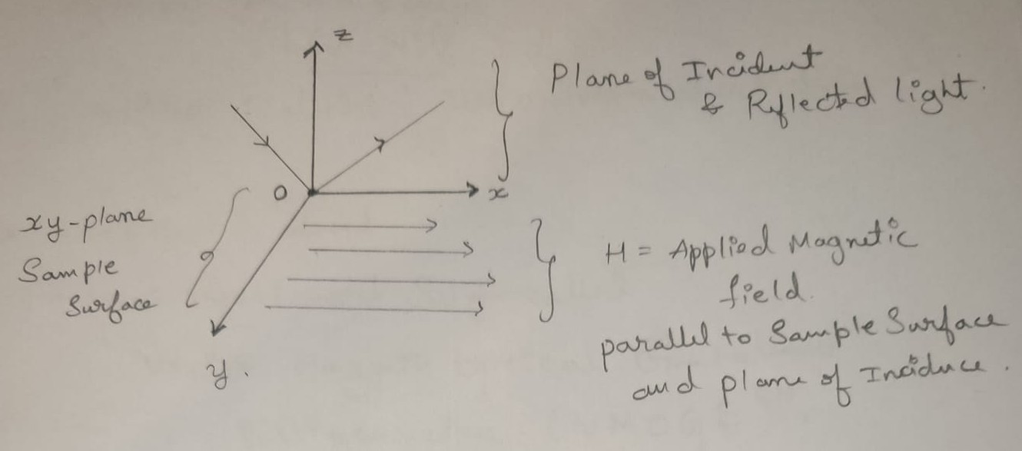

VMOGE Configurations
Longitudinal Configuration (L-VMOGE):
Magnetic field H is applied parallel to both the sample surface and the plane of incidence.
By this Analogy the Magnetic Field along y and z-axis of the sample is Zero.
$H_{x}≠0, H_{y}=H_{z}=0$

Slide 6
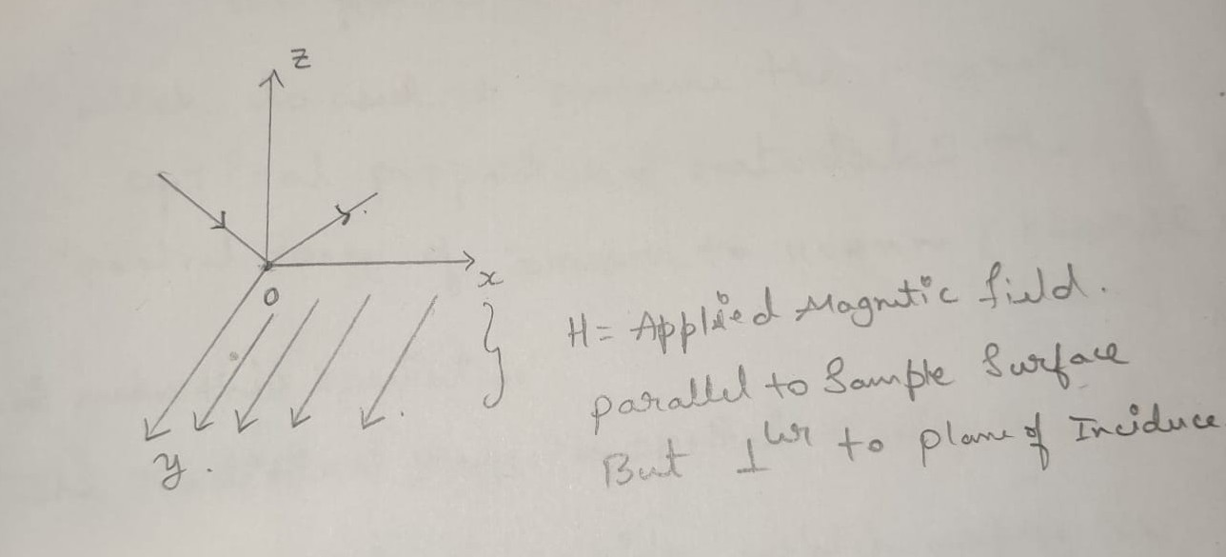

VMOGE Configurations
Transverse Configuration (T-VMOGE):
Magnetic field H is applied parallel to the sample surface but perpendicular to the plane of incidence.
The Magnetic Field along x and z-axis of the sample is Zero.
$H_{y}≠0, H_{x}=H_{z}=0$

Slide 7
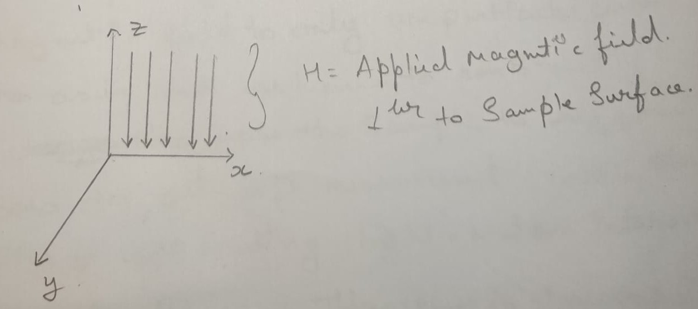

VMOGE Configurations
Polar Configuration (P-VMOGE):
Magnetic field H is applied perpendicular to the sample surface.
The Magnetic Field along x and y-axis of the sample is Zero.
$H_{z}≠0, H_{x}=H_{y}=0$

Slide 9
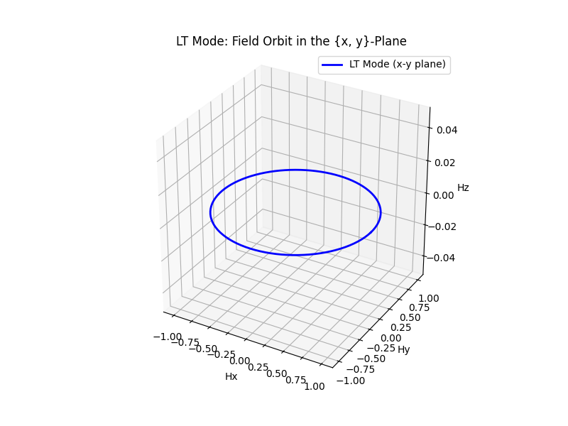

VMOGE Modes
Field Orbit: A closed spatial loop in 3D vector space where the magnetic field orientation is varied while keeping its magnitude constant
We describe the field orbits using something called as VMOGE Modes. There are 3 VMOGE Modes which are as follows.
Longitude-Transverse Mode (LT-Mode):
Magnetic field H is swept in the {x, y}-plane (sample surface plane)
For this case, the Polar Angle $θ_{m}=90° \left(remains same\right)$ and $φ_{m}$ varies from 0° to 360°
This one entire circle /loop that we see in the 3D Vector Space is
formed by Magnetic Field, and this One Loop is called as Field Orbit

Slide 10
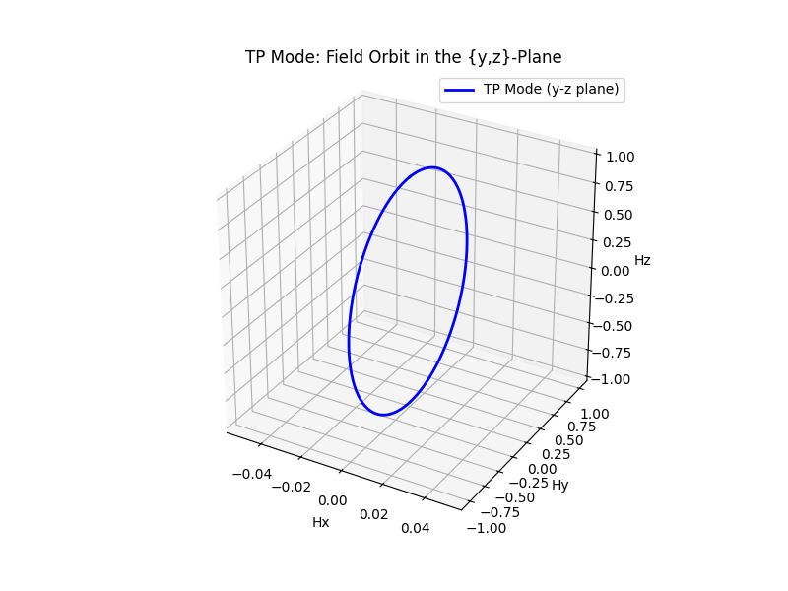
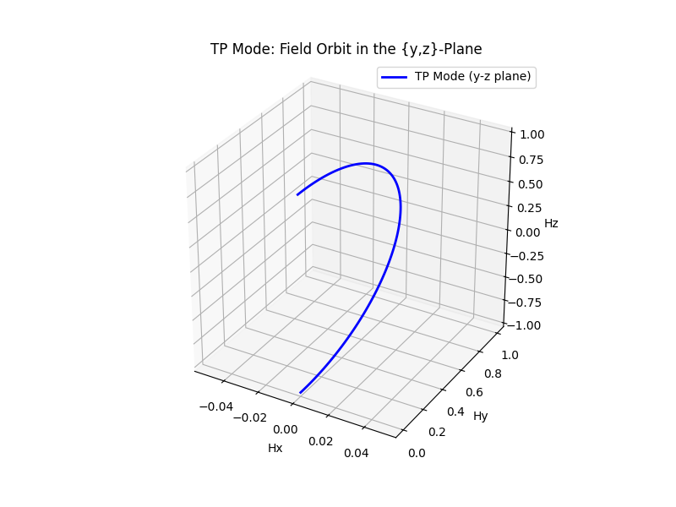

VMOGE Modes
Transverse-Polar Mode (TP-Mode):
Magnetic Field Sweeps across the y-z plane.
For this case, the Azimuth Angle $φ_{m}=90° \left(remains same\right)$ and $θ_{m}$ varies from 0° to 180°
For one full loop we need to vary $θ_{m}$ from 0° to 360° (which is typically not required)

Slide 11
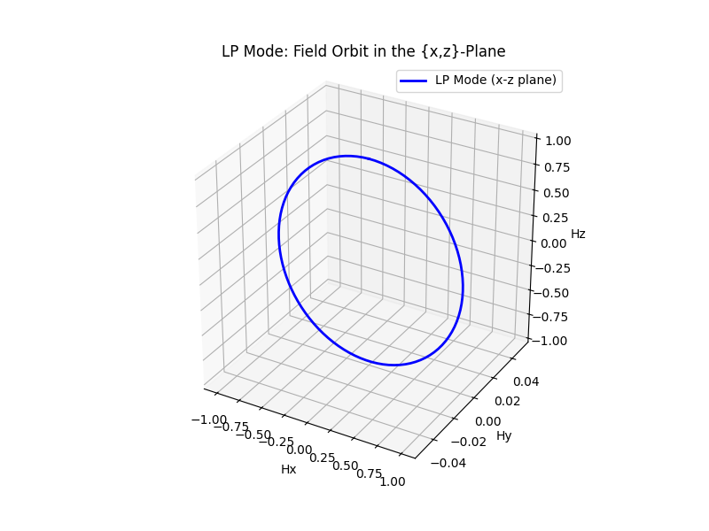
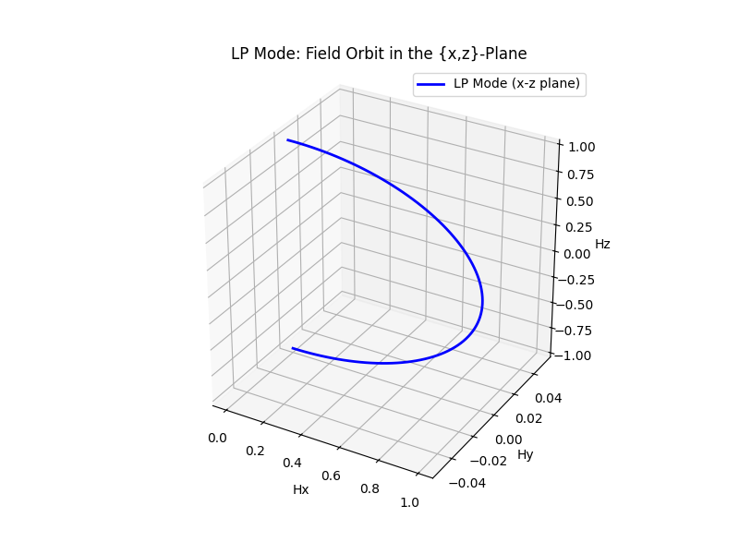

VMOGE Modes
LP-VMOGE (Longitudinal-Polar):
Magnetic Field H sweeps along the (x-z plane)(plane of incidence)
For this case, the Azimuth Angle $φ_{m}$= 0° (remains same) and $θ_{m}$ varies from 0° to 180°
For one full loop we need to vary $θ_{m}$ from 0° to 360° (which is typically not required)

Slide 12

Mueller Matrix Formalism
Mueller Matrix is a 4x4 Matrix which basically connects the Light Incident on the Sample Surface and Reflected Outgoing Light.
It captures the modifications in polarisation state of the Incoming Light and Outgoing Light by connecting the Stokes Vector of Incoming Light ($S_{in})$ and Outgoing Light ($S_{out}$) by the following equation
$$S_{in}=M{.S}_{out}$$
M is a Matrix and each element in it represents the specific transformation of the polarization state.

Slide 13
Mueller Matrix Formalism
For the Case of VMOGE, we consider the Upper 3 x 4 Matrix of this Mueller 4 x 4 Matrix, as it is sufficient to characterize the MO response of the sample.
Mueller Matrix is quite useful tool for the cases of Multilayer thin films, which have different materials in different layer.
The 4×4 matrix formalism also allows the evaluation of a set of 16 Mueller matrix elements independence of magnetic field H for a multilayer system.

Slide 14

Mueller Matrix Formalism
The nonsymmetric terms of the Mueller Matrix are induced by the magneto-optical dielectric tensor ($ε^{MO}$).
The Dielectric Tensor of each layer is analysed for Non Symmetric Terms $ε_{ij}^{MO}$and these terms are assumed to be dependent on the Magnetisation (M). They are related to M by the anisotropic complex valued MO coupling constants ($Q_{x}$, $Q_{y}$, $Q_{z}$).
$ε^{MO}$ 3x4 matrix can be obtained by performing complicated mathematical steps (Linear Response Theory & Levi Civita Formalism)

Slide 15

Magneto-optical dielectric tensor
$ε^{MO}$ 3x4 matrix can be obtained by performing complicated mathematical steps (Linear Response Theory & Levi Civita Formalism) as following Matrix,
$$\begin{matrix}ε_{x} & −iQ_{z}M_{z} & iQ_{y}M_{y} \\ iQ_{z}M_{z} & ε_{y} & −iQ_{x}M_{x} \\ −iQ_{y}M_{y} & iQ_{x}M_{x} & ε_{z}\end{matrix}=ε^{MO}$$

Slide 16
Magneto-optical dielectric tensor
The Dielectric Tensor matrix elements are just a result of single mode, instead they are combined overall picture of all the modes.
Some Particular Dielectric Tensor Matric Elements can be accessed only using one of the 3 VMOGE modes as mentioned earlier.
Hence the Mueller Matrix formalism is very useful way to understand the thin film characterisation as it captures the overall picture of polarization changes of incident light induced by the sample.
By fitting the experimental Mueller Matrix data to a theoretical model, we can determine the magneto-optical dielectric tensor, which further can be used to predict the MO response for any angle of incidence or Magnetic Field Orientation.
It enables the study of magnetic anisotropy and the magneto-optical response of thin films and nanostructures.

Slide 17
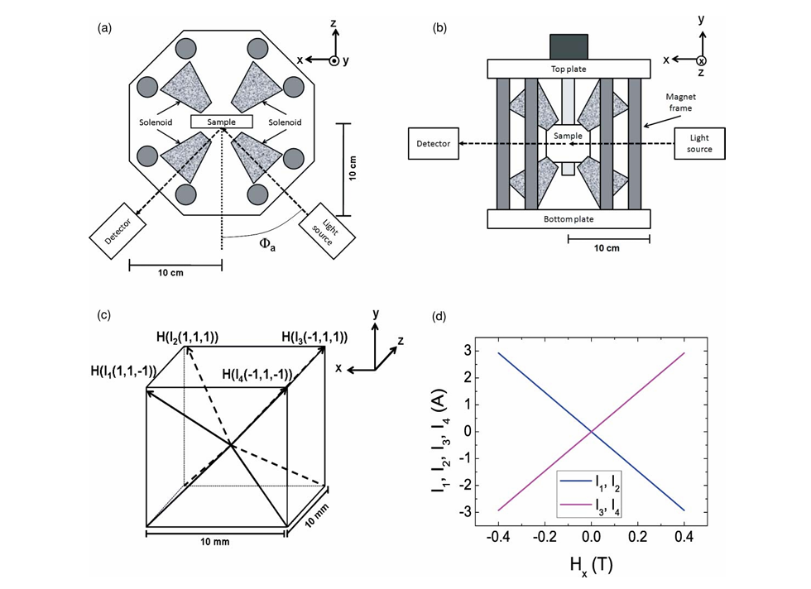
VMOGE Setup and Analysis

Slide 18

VMOGE Setup and Analysis
The Magnetic Field Strength and its relationship with the current on Solenoids can be determined using the following equations,
$$4αH_{x}=I_{1}e_{1}+I_{2}e_{2}−I_{3}e_{3}−I_{4}e_{4}$$
$$4αH_{y}=I_{1}e_{1}+I_{2}e_{2}+I_{3}e_{3}+I_{4}e_{4}$$
$$4αH_{z}={−I}_{1}e_{1}+I_{2}e_{2}+I_{3}e_{3}−I_{4}e_{4}$$
Rearranging the above equation we get something like this,
$$2αH_{y}−2αH_{z}−I_{4}e_{4}=I_{1}e_{1}$$
$$2αH_{x}+2αH_{z}+I_{4}e_{4}=I_{2}e_{2}$$
$$2αH_{y}−2αH_{x}−I_{4}e_{4}=I_{3}e_{3}$$
As you can see in both the cases, we have 3 linear Equations and 4 Unknown Current Values. Hence they are called as Overdetermined and they can have many solutions.
[1]
[2]

Slide 19
VMOGE Setup and Analysis
To overcome this situation we utilise something called as Minimum Norm Solution, which gives us one unique solution for Total Magnetic Field (H).
The Minimum Norm Solution is useful tool here as it ensures that with the varying current in the solenoid, the variation in Magnetic Field can be predicted [figure(d)].
This basically tells us that we can control the current flowing through solenoid and adjust the magnetic field generated by it.
Minimum Norm Solution is calculated using some linear algebraic operations.

Slide 20
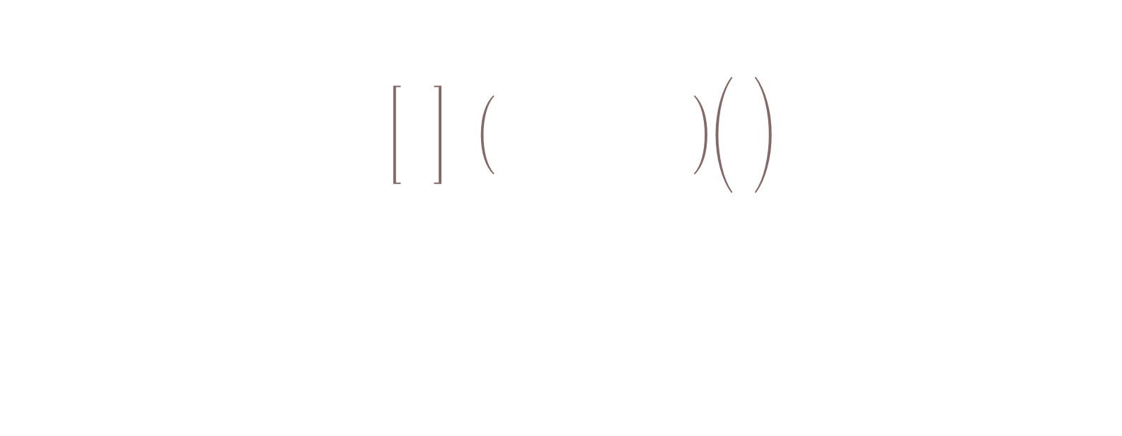
Minimum Norm Solution Calculation
Using one of the following set of equations we write down the Matrix Equation Form,
$$4α\left[\begin{matrix}H_{x} \\ H_{y} \\ H_{z}\end{matrix}\right]=\left(\begin{matrix}1 & 1 & −1 & −1 \\ 1 & 1 & 1 & 1 \\ −1 & 1 & 1 & −1\end{matrix}\right)\left(\begin{matrix}I_{1} \\ I_{2} \\ I_{3} \\ I_{4}\end{matrix}\right)$$
$$4αH=AI$$
Where,
A = 3 x 4 Matrix with Current Coefficients,
I = 4 x 1 Matrix with Current Vectors
H = 3 x 1 Magnetic Field Vector Components

Slide 21

Minimum Norm Solution Calculation
The previously mentioned equation can be re written as,
$$4αH=AI ⇒I= A^{+}4αH$$
Here,
$A^{+}$ is a Pseudoinverse Matrix / Moore Penrose Pseudoinverse Matrix
(This is calculated using Singular Value Decomposition (SVD))
Using this we calculate the values of Current and accordingly we can obtain the desired Magnetic Field.

Slide 22
Converting Cartesian Components to Octupole Coordinates
From the set of Eq.[1], we have obtained the relationship between artesian components of the magnetic field and the currents.
As mentioned earlier we can solve for the current values using Minimum Norm Solution, to obtain the desired Total Magnetic Field (H)
This (H) will be basically the resulting magnetic field generated due to the current.
We can use the Polar Coordinate and Cartesian Coordinate Relation and basically obtain the Total Magnetic Field in terms of Polar Coordinates too.

Slide 23
From Magnetic Field to Mueller Matrix
Minimum Norm Solution: Calibrates solenoid currents to generate precise 3D magnetic fields.
Fixed Sample Setup: Magnetic field applied in any direction without moving the sample.
Ellipsometer Input: Light (200–1000 nm) incidents on the sample, interacts, and reflects.
Mueller Matrix Output: Captures polarization changes induced by the sample.
LT Mode: Studies in-plane magnetic properties in the {x, y}-plane.
LP Mode: Studies out-of-plane properties in the {x, z}-plane.
TP Mode: Studies out-of-plane properties in the {y, z}-plane.
Combined Data: Full Mueller Matrix reveals magneto-optical (MO) response of multilayer films.
Wavelength Adjustment: Tune light wavelength to study material-specific MO interactions.
Complete Characterization: Determines MO dielectric tensor, anisotropy, and layer properties.

